Slide 1


Task-3
Hotel Aggregator Analysis Using Power-BI
Presenting by
SHRIYA K
1

Slide 2

HOTEL AGGREGATOR ANALYSIS
Overview :
A hotel aggregator is a business that rents a hotel on lease, and in exchange takes over operational duties and marketing for the hotels. The hotel can lease a fixed amount of rooms or the entire hotel.

Slide 3
Problem Statement:
This internship project aims to analyze a dataset of hotel aggregator listings
using Power BI.
The dataset comprises various attributes related to listings, hosts, reviews, and availability.
The objective is to create comprehensive visualizations and insights that shed light on trends, patterns, and factors influencing the performance of listings.
Through Power BI, interns will explore key metrics such as pricing, availability, host characteristics, and review scores to derive actionable insights for improving the overall quality and competitiveness of the listings.

Slide 4
DATABASE SETUP AND TOOL USED:
DATABASE NAME: HOTEL AGGREGATOR ANALYSIS
DATA USED : CSV FILE
TOOL USED: POWER BI

Slide 5
Dataset Description:
1. id: Unique identifier for each listing.
2. listing_url: URL of the listing on the hotel aggregator platform.
3. scrape_id: Identifier for the data scraping event.
4. last_scraped: Date of the last data scrape.
5. source: Source of the listing information.
6. name: Name of the listing.
7. description: Description of the listing.
8. neighborhood_overview: Overview of the neighborhood where the listing is located.
9. picture_url: URL of the listing's picture.
10. host_id: Unique identifier for the host.
11. ... (and many more columns capturing details about hosts, location, property type, room details,
amenities, pricing, availability, reviews, and other relevant information)
5

Slide 6
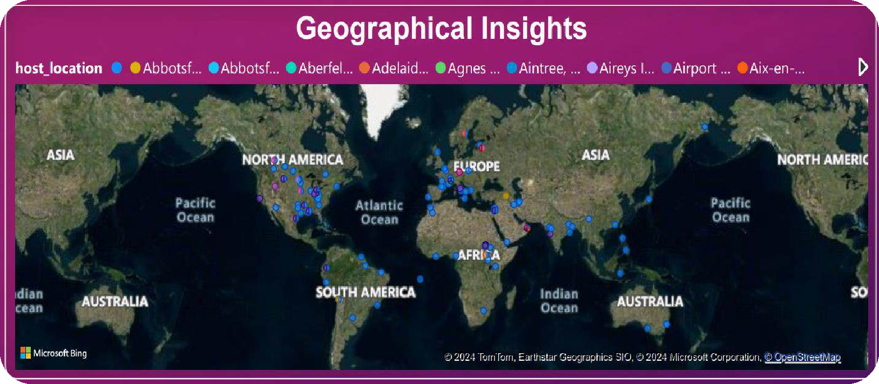

Project Objectives:
1. Geographical Insights:
Visualize the distribution of listings on a map to identify popular neighborhoods.
Explore the geographical concentration of listings and host locations.

Slide 7
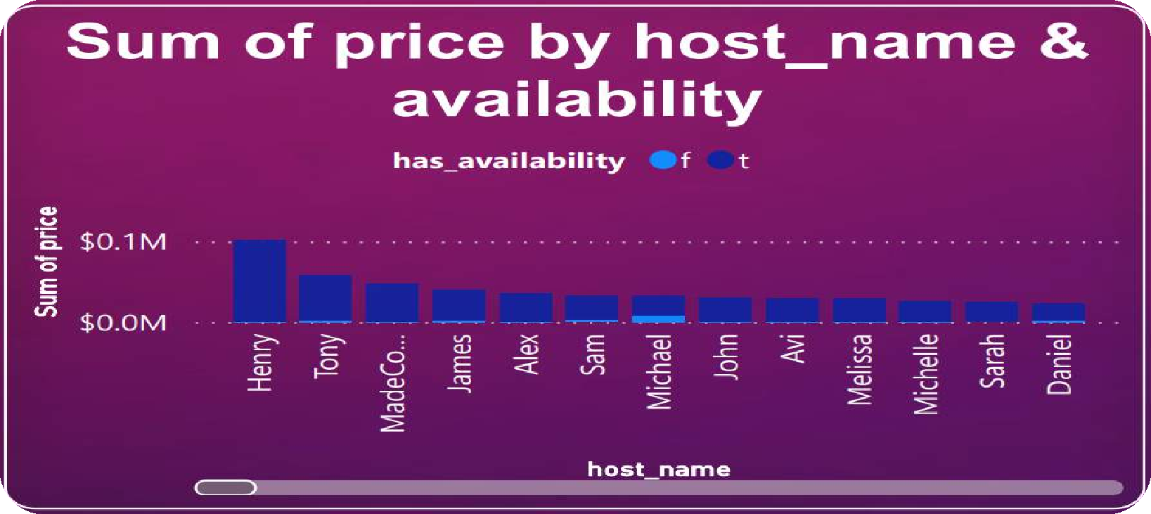

Project Objectives:
2.Pricing and Availability Analysis:
Analyze pricing trends based on property types, room types, and accommodation capacity.
Investigate the availability of listings over time and identify peak periods.

Slide 8
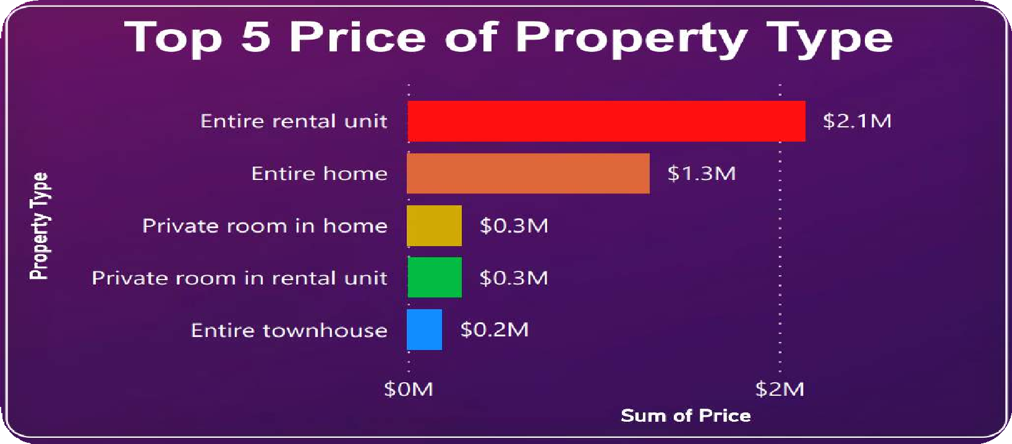

Project Objectives:
3. Host Performance:
Evaluate host characteristics, including super host status, response times, and verification methods.
Explore correlations between host attributes and listing performance.

Slide 9
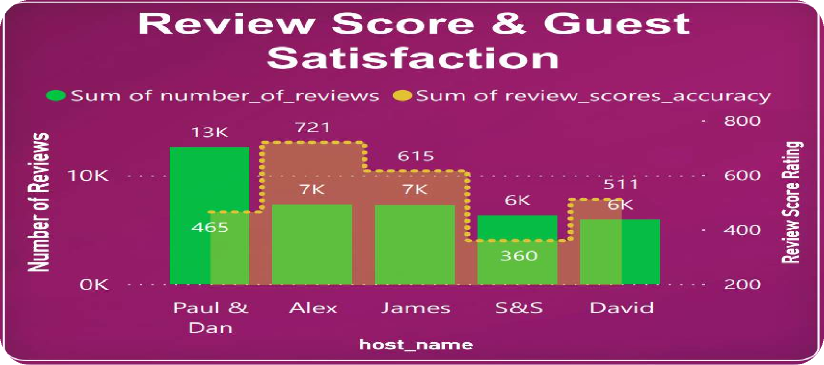

Project Objectives:
4. Review Scores and Guest Satisfaction:
Examine review scores and their impact on overall listing performance.
Identify areas for improvement based on specific review categories.

Slide 10
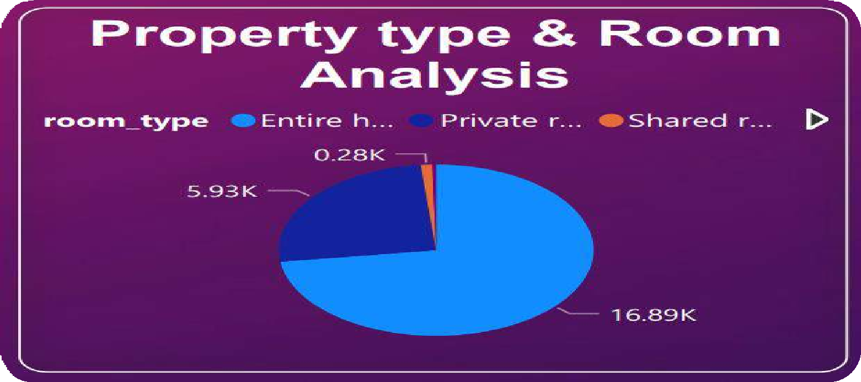

Project Objectives:
5. Property Type and Room Analysis:
Analyze the distribution of property types and room types.
Explore trends in the popularity of specific accommodation setups.

Slide 11
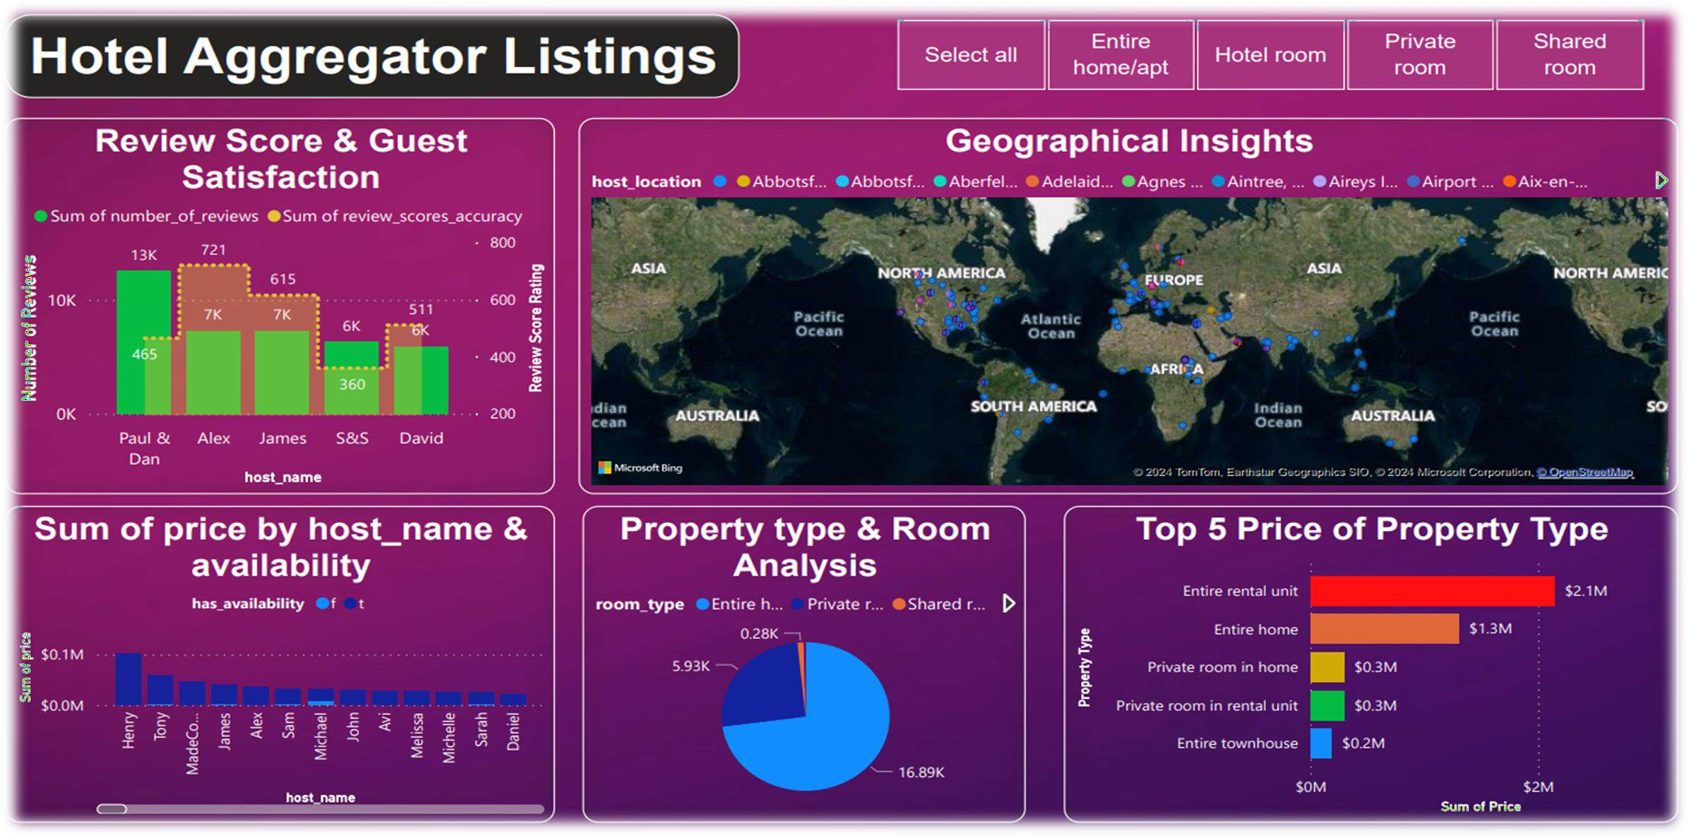
DASHBOARD
11

Slide 12

12

